Slide 1
Nada Ozone Miltons
SURFACE-TO-AIR (QUALITY) MISSION
Mapping the world's air, earning your trust

Slide 2
RATIONALE
Air pollution is associated with almost 5 million annual deaths worldwide
Costs the global economy $225 billion in lost labor income
Aim: Air quality measure that is
Unified
Real-time
Localised
Accurate
Easy to visualise.

Slide 3
Our idea
Air quality stations send data to our centralised weather store
Evaluate credibility/confidence of data source, weighted by:
Frequency of input
Comparing input against data from stations at nearby locations
Optional: source-quoted confidence interval / uncertainty
Generation of detailed air quality “surface” based on most accurate/reliable air quality data.
Visualise air quality surface on publicly accessible web app

Slide 4
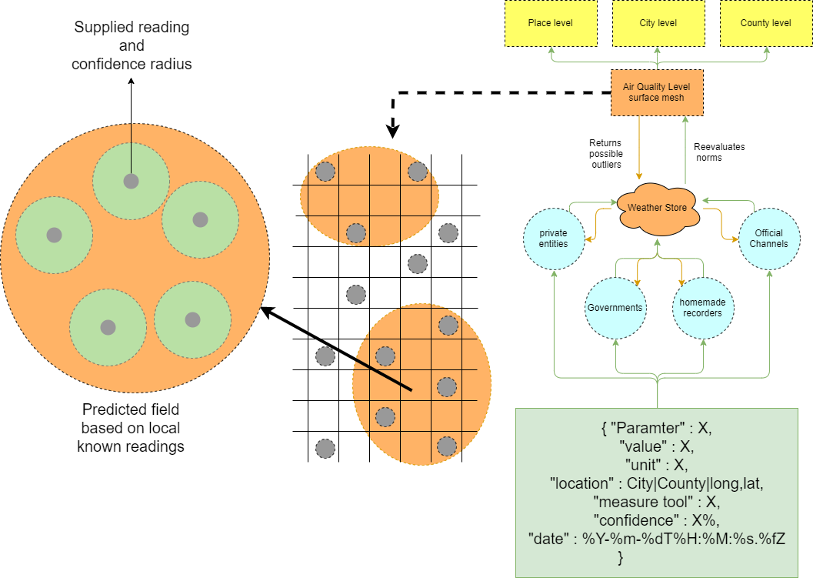
Universal data collection

Slide 5
Weather store / data lake

Slide 6
Evaluation of sources

Slide 7
Generate air quality surface

Slide 8
Visualise mesh

Slide 9
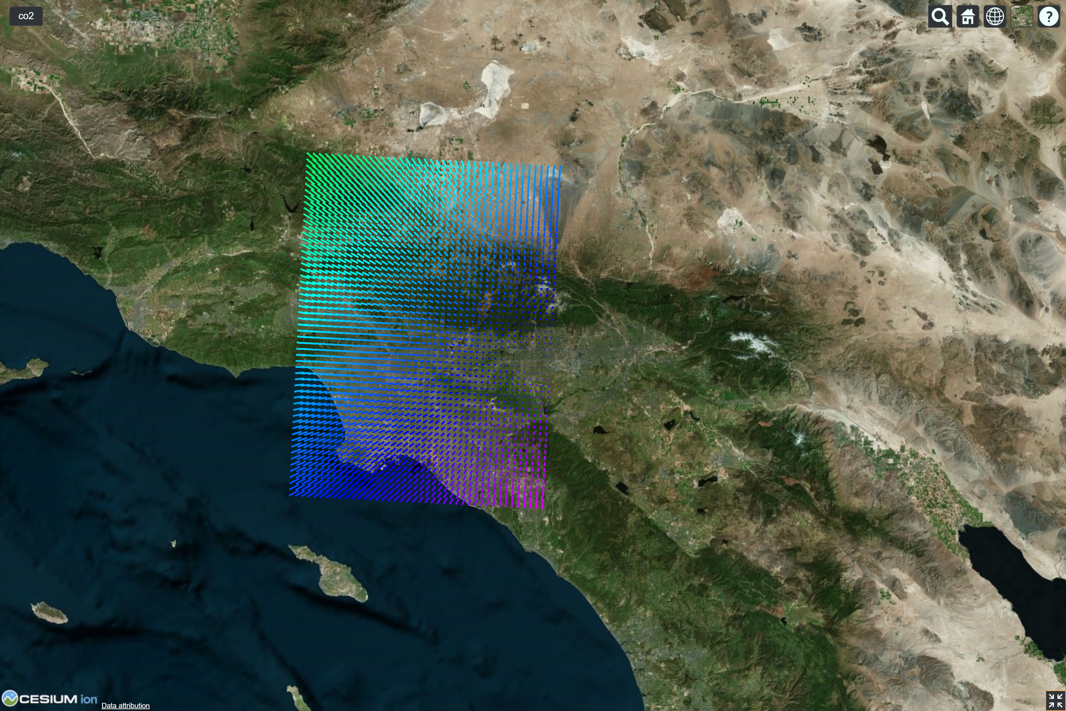
Visualisation of air quality surface

